Slide 1
Chapter 3: The Link Layer
Our goals:
understand principles behind data link layer services:
framing
error detection, correction
reliable data transfer, flow control
sharing a broadcast channel: multiple access
link layer addressing
Overview:
link layer services
framing
error detection, correction
reliable data transfer
multiple access protocols and LANs
link layer addressing

Slide 2
Keypoints and Difficulties
Keypoints:
Four framing methods
CRC
reliable data transfer
multiple access protocols
link layer addressing
Difficulties:
CRC
Flow control
Sliding-window protocol
CSMA/CD

Slide 3

















Link layer: Introduction
terminology:
hosts and routers: nodes
communication channels that connect adjacent nodes along communication path: links
wired links
wireless links
LANs
layer-2 packet: frame, encapsulates datagram
data-link layer has responsibility of
transferring datagram from one node
to physically adjacent node over a link

Slide 4
Link layer: context
datagram transferred by different link protocols over different links:
e.g., Ethernet on first link, frame relay on intermediate links, 802.11 on last link
each link protocol provides different services
e.g., may or may not provide rdt over link
transportation analogy:
trip from Princeton to Lausanne
car: Princeton to JFK
plane: JFK to Geneva
train: Geneva to Lausanne
tourist = datagram
transport segment = communication link
transportation mode = link layer protocol
travel agent = routing algorithm
Notes:
中间链路上的帧中继

Slide 5
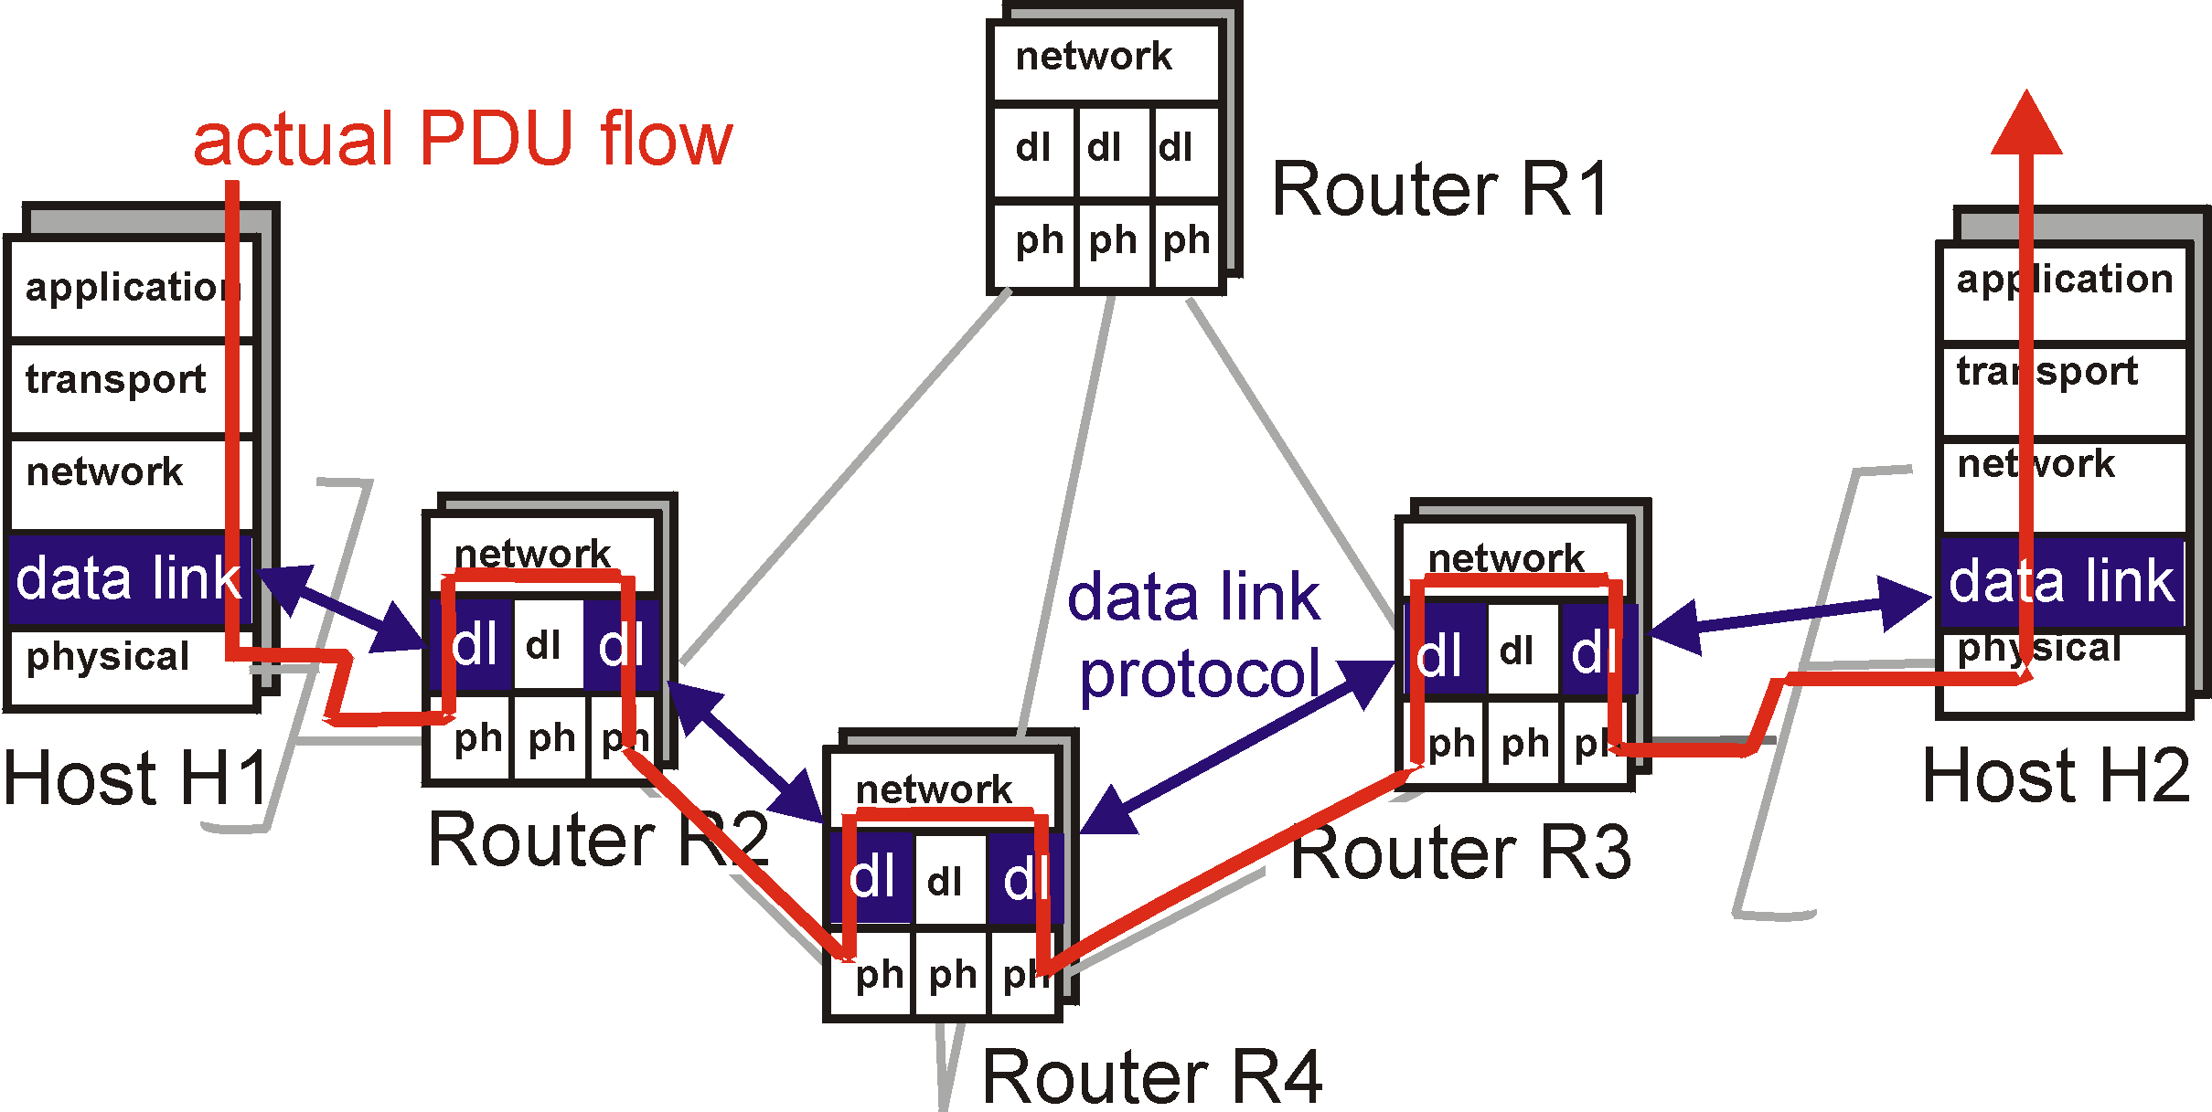
Link Layer: setting the context

Slide 6
Link Layer: setting the context
two physically connected devices:
host-router, router-router, host-host
unit of data: frame
M
application
transport
network
link
physical
network
link
physical
H
t
M
H
H
M
data link
protocol
n
t
H
H
H
H
H
H
M
l
n
t
M
l
n
t
frame
phys. link
adapter card

Slide 7
Link Layer: Implementation
implemented in “adapter”
e.g., PCMCIA card, Ethernet card
typically includes: RAM, DSP chips, host bus interface, and link interface
M
application
transport
network
link
physical
network
link
physical
H
t
M
H
H
M
data link
protocol
n
t
H
H
H
H
H
H
M
l
n
t
M
l
n
t
frame
phys. link
adapter card

Slide 8
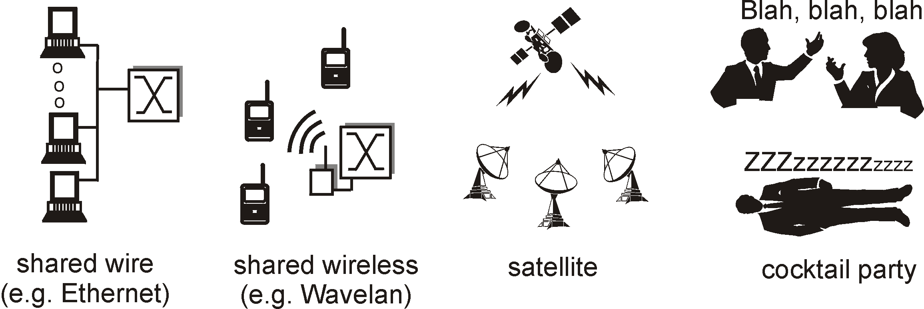
Multiple Access Links and Protocols
Three types of “links”:
point-to-point (single wire, e.g. PPP, SLIP)
broadcast (shared wire or medium; e.g, Ethernet, Wavelan, etc.)
switched (e.g., switched Ethernet, ATM etc)
3-8

Slide 9
Link Layer Services
Framing, link access:
encapsulate datagram into frame, adding header, trailer
implement channel access if shared medium,
‘physical addresses’ used in frame headers to identify source, dest
Reliable delivery between two physically connected devices:
Reliable data transfer protocol
seldom used on low bit error link (fiber, some twisted pair)
wireless links: high error rates

Slide 10
Link Layer Services (more)
Flow Control:
pacing between sender and receivers
Error Detection:
errors caused by signal attenuation, noise.
receiver detects presence of errors:
signals sender for retransmission or drops frame
Error Correction:
receiver identifies and corrects bit error(s) without resorting to retransmission

Slide 11
Framing
Character count method :
encapsulate datagram into frame, adding header (character number)
Counting header
Counting header
10
Data in frame1
6
Data in frame 2
Frame 1
Frame 2
Sending in the front

Slide 12
Framing
First and tail bound method based on character:
encapsulate datagram into frame, adding header, trailer (character)
Beginning character
Ending character
SOH
Data in the frame
EOT
frame
Sending in the front

Slide 13
Framing
First and tail bound method based on character:
encapsulate datagram into frame, adding header, trailer (character)
appear“EOT”
Complete frame
data
SOH
EOT
EOT
Sending in the front
Be mistaken for a frame
By the receiver
Be discarded as a invalid frame

Slide 14
Framing
First and tail bound method based on character:
Inserting/ stuffing a Escape character before the special character in the data part
Beginning character
Ending character
Original data
SOH
EOT
SOH
ESC
SOH
EOT
Byte stuffing
Byte stuffing
Byte stuffing
Byte stuffing
SOH
ESC
EOT
ESC
SOH
ESC
ESC
ESC
SOH
EOT
Date sent with byte stuffing
Sending in the front

Slide 15
Framing
First and tail bound method based on bit:
encapsulate datagram into frame, adding header, trailer (bit sequence)
Beginning bit sequence
Ending bit sequence
01111110
Data in the frame
01111110
frame
Sending in the front

Slide 16
Framing
First and tail bound method based on bit:
Inserting a bit “0” after successive five bits “0” in the transmitter; vice versa
Beginning bit sequence
Ending bit sequence
Original data
01111110
01110101111111101100011111000
01111110
Bit 0 inserting
Bit 0 inserting
01111110
0111010111110111011000111110000
01111110
Date sent with bit stuffing
Sending in the front

Slide 17
Framing
Physical layer coding violation method:
encapsulate datagram into frame without stuffing
Only be used in the networks with redundancy coding technology in the physical layer
For example (IEEE 802.11 with Manchester code):
Bit 1 with level jump mode from high to low
Bit 0 with level jump mode from low to high
Level jump modes from high to high or from low to low can be used for beginning and ending of a frame

Slide 18
Exercise-1
1. HDLC protocol sets the bit stream 0111110001111110 after framing as ( )
A. 011111000011111010 B.011111000111110101111110 C.01111100011111010 D.011111000111111001111101
3-18

Slide 19
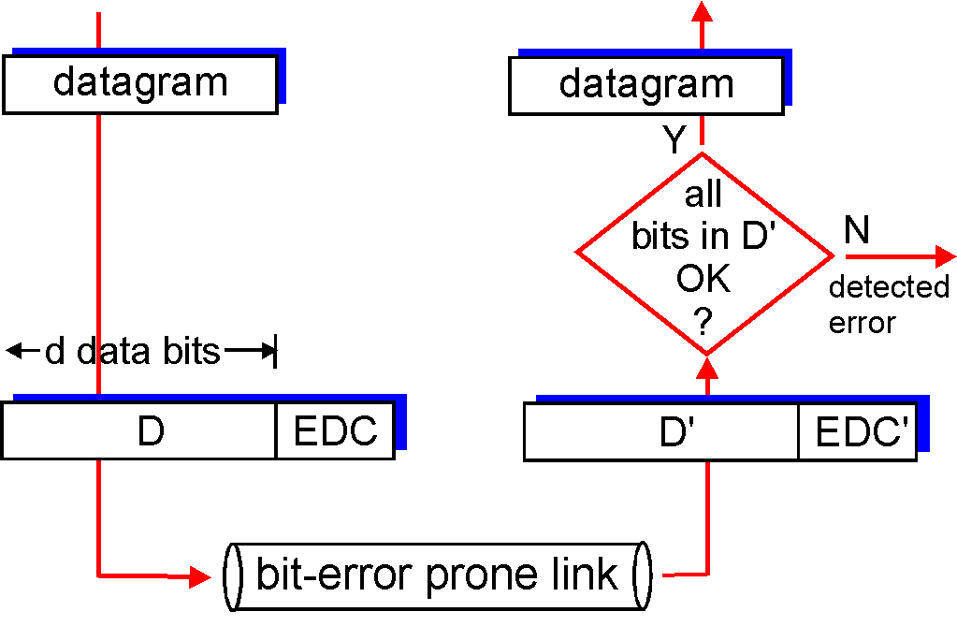
Error Detection
EDC= Error Detection and Correction bits (redundancy)
D = Data protected by error checking, may include header fields
Error detection not 100% reliable!
protocol may miss some errors, but rarely
larger EDC field yields better detection and correction
Notes:
D: 信息位， EDC：监督位
抗干扰编码：1）任何算法不可能100%检错，关心算法的检错能力 2）一般，监督位数越多，检错或纠错能力越强，但要注意算法运行效率和编码效率D/D+EDC
差错编码分类：1）信息位和监督位的关系：线性码（CRC/奇偶校验码）、非线性码（卷积码）
2）用途或功能：检错码（CRC）、纠错码（海明编码、交织码），交织编码根据交织方式的不同，可分为线性交织、卷积交织和伪随机交织。

Slide 20
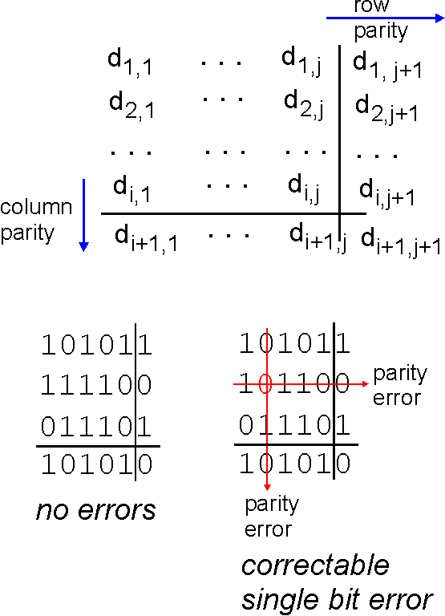
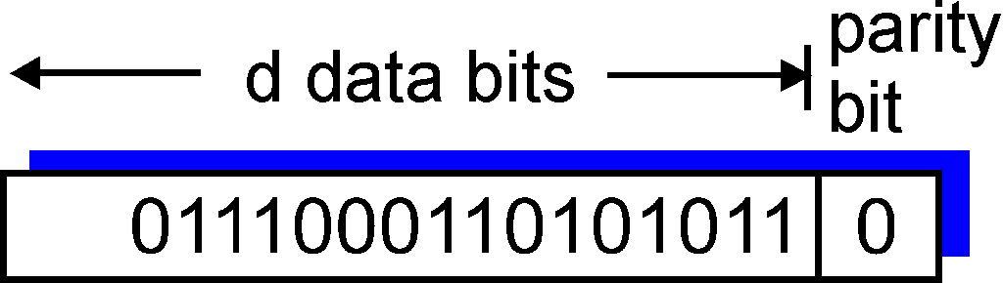
Parity Checking
Single Bit Parity:
Detect single bit errors
Two Dimensional Bit Parity:
Detect and correct single bit errors
0
0

Slide 21
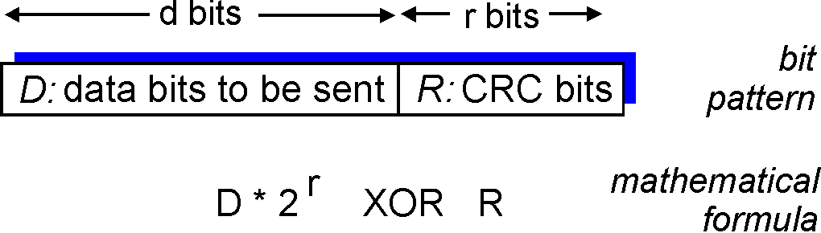
Checksumming: Cyclic Redundancy Check
view data bits, D, as a binary number
choose r+1 bit pattern (generator), G
goal: choose r CRC bits, R, such that
<D,R> exactly divisible by G (modulo 2)
receiver knows G, divides <D,R> by G. If non-zero remainder: error detected!
can detect all burst errors less than r+1 bits
widely used in practice (ATM, HDCL)

Slide 22
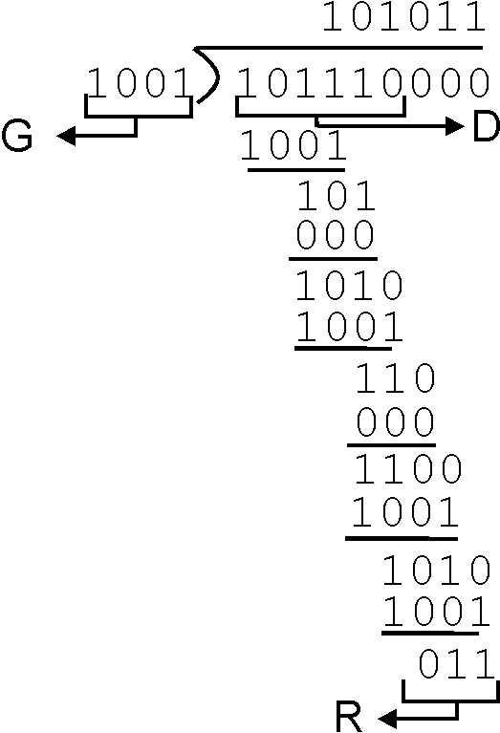
CRC Example
Want:
D.2r XOR R = nG
equivalently:
D.2r = nG XOR R
equivalently:
if we divide D.2r by G, want reminder R
D.2r
G
R = remainder[ ]

Slide 23
CRC well-known generator
CRC-12：x¹² +x¹¹ +x³ +x² +x¹ + 1
CRC-16 ：x¹⁶ +x¹⁵ +x² + 1
CRC-CCITT ：x¹⁶ +x¹² +x⁵ + 1
CRC-32：x³² +x²⁶ +x²³ +x²² +x¹⁶ +x¹² +x¹¹ +x¹⁰ +x⁸ +x⁷ +x⁵ +x⁴ +x² +x¹ + 1
CCITT：Consultative Committee on International Telegraphy and Telephone
ITU-T：International Telecommunications Union – Telecommunications Standardization Sector
Notes:
Consultative Committee on International Telegraphy and Telephone国际电报电话咨询委员会

Slide 24
Exercise-2
1. If the information received by an Ethernet adapter is 101101001 and the generator is G(x) = x³+x²+1, judge whether the transmission has bit error?
3-24

Slide 25
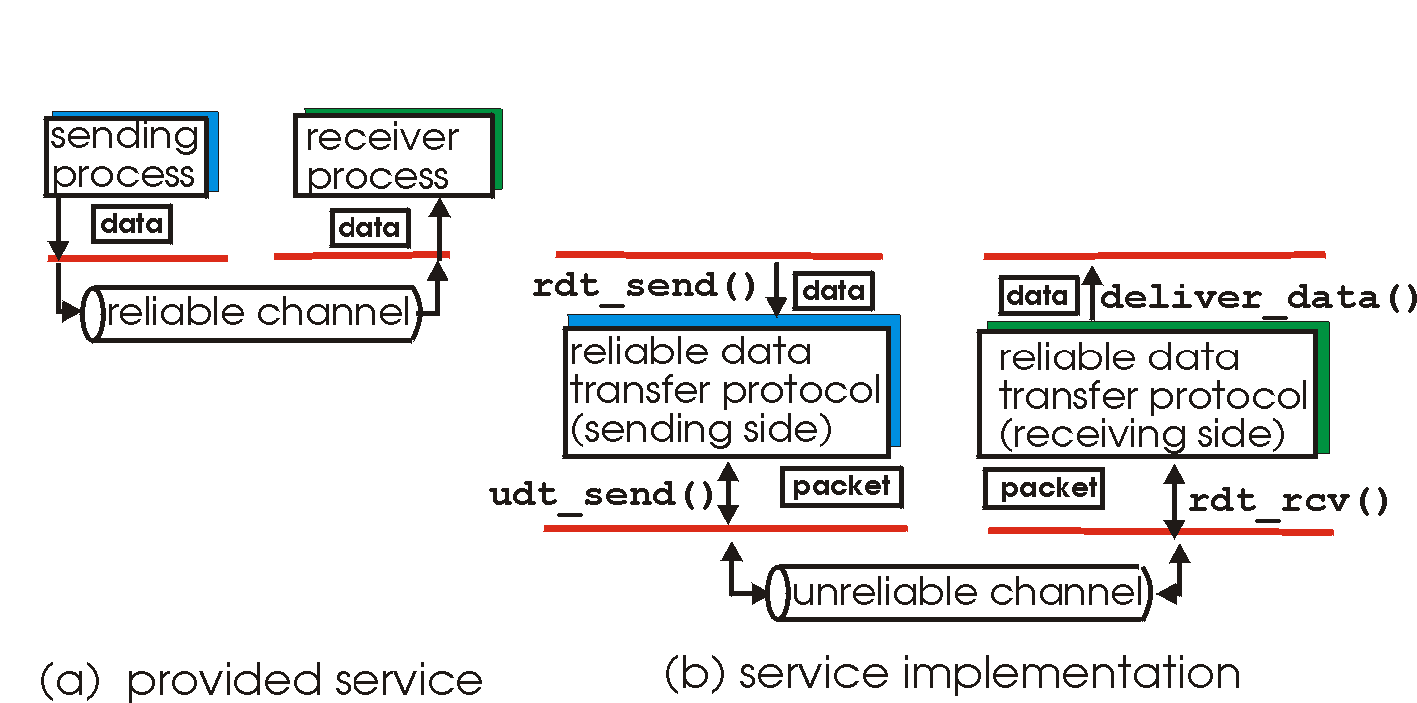
Reliable Data Transfer
Important in app., transport, link layers
Top-10 list of important networking topics!
Characteristics of unreliable channel will determine complexity of reliable data transfer protocol (rdt)

Slide 26
Stop-and-Wait
sender
receiver
first packet bit transmitted, t = 0
last packet bit transmitted, t = L / R
first packet bit arrives
RTT: Round-Trip Time
last packet bit arrives, send ACK
ACK arrives, send next
packet, t = RTT + L / R

Slide 27
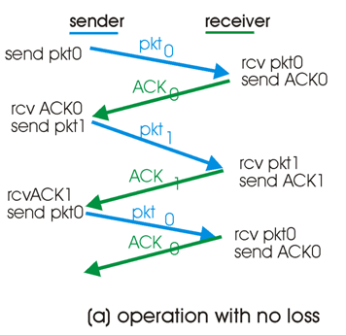
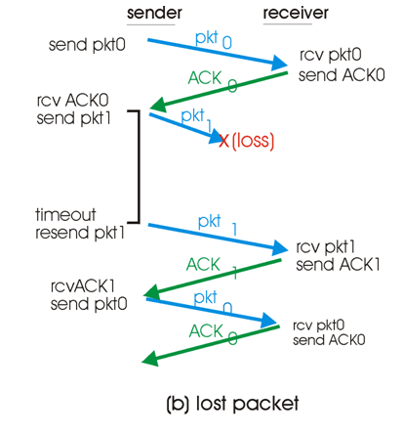
Stop-and-Wait

Slide 28
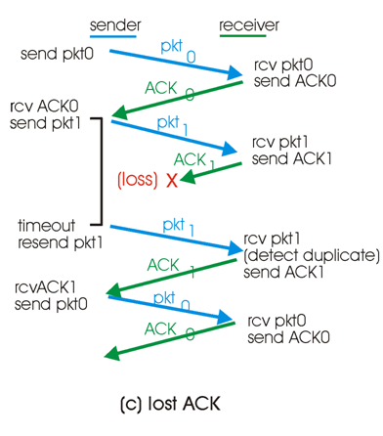
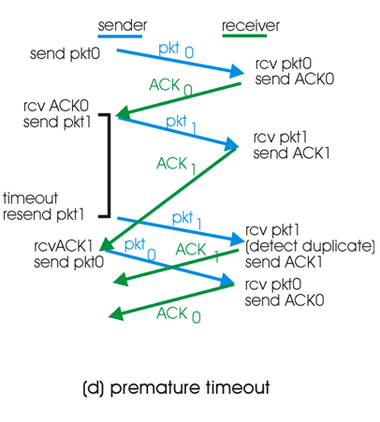
Stop-and-Wait

Slide 29
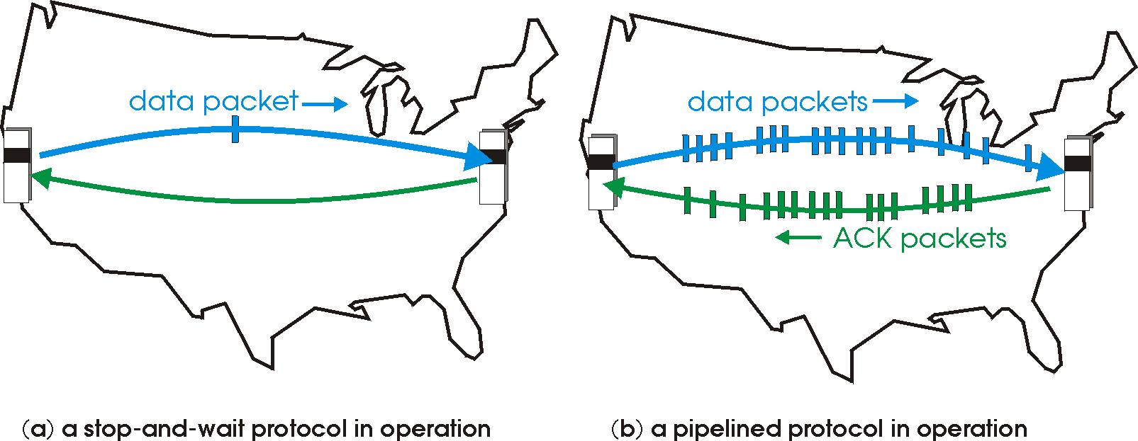
Pipelined Protocols
Pipelining: sender allows multiple, “in-flight”, yet-to-be-acknowledged pkts
Range of sequence numbers must be increased
Buffering at sender and/or receiver

Slide 30
Pipelined Protocols
Advantage: much better bandwidth utilization than stop-and-wait
Disadvantage: More complicated to deal with reliability issues, e.g., corrupted, lost, out of order data.
Two generic approaches to solving this
Go-Back-N protocols
Selective repeat protocols
Note: TCP is not exactly either

Slide 31
Pipelining: Increased Utilization
sender
receiver
first packet bit transmitted, t = 0
last bit transmitted, t = L / R
first packet bit arrives
RTT
last packet bit arrives, send ACK
last bit of 2nd packet arrives, send ACK
last bit of 3rd packet arrives, send ACK
ACK arrives, send next
packet, t = RTT + L / R
Increase utilization
by a factor of 3!

Slide 32
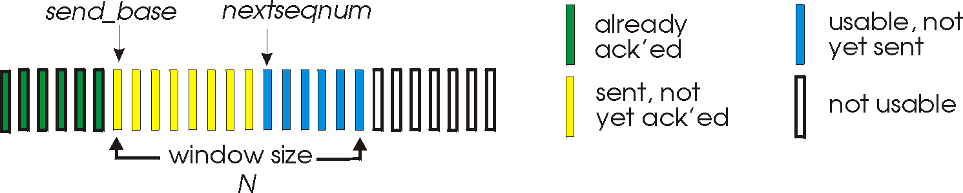
Go-Back-N
Sender:
K-bit seq # in pkt header
“Window” of up to N, consecutive unack’ed pkts allowed
ACK(n): ACKs all pkts up to, including seq # n - “cumulative ACK”
May receive duplicate ACKs (see receiver)
Timer for each in-flight pkt
Timeout(n): retransmit pkt n and all higher seq # pkts in window
Called a sliding-window protocol

Slide 33
GBN: Sender
rdt_Send() called: checks to see if window is full
No: send out packet
Yes: return data to upper level
Receipt of ACK(n): cumulative acknowledgement that all packets up to and including n have been received. Updates window accordingly and restarts timer
Timeout: resends ALL packets that have been sent but not yet acknowledged.
This is only event that triggers resend

Slide 34
More on Receiver
ACK-only: the receiver always sends ACK for last correctly received packet with highest in-order seq #
Receiver only sends ACKS (no NAKs)
Need only remember expectedseqnum
Can generate duplicate ACKs

Slide 35
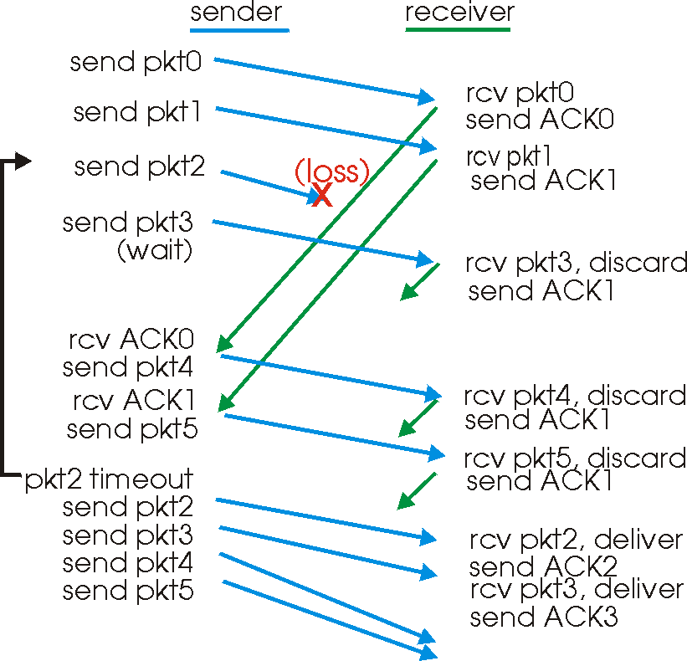
GBN In Action

Slide 36
GBN is easy to code but might have performance problems
In particular, if many packets are in pipeline at one time (bandwidth-delay product large) then one error can force retransmission of huge amounts of data!
Selective Repeat protocol allows receiver to buffer data and only forces retransmission of required packets
Notes:
.

Slide 37
Selective Repeat
Receiver individually acknowledges all correctly received pkts
Buffers pkts, as needed, for eventual in-order delivery to upper layer
Sender only resends pkts for which ACK not received
Sender timer for each unACKed pkt
Compare to GBN which only had timer for base packet
Sender window
N consecutive seq #’s
Again limits seq #s of sent, unACKed pkts
Important: Window size < seq # range

Slide 38
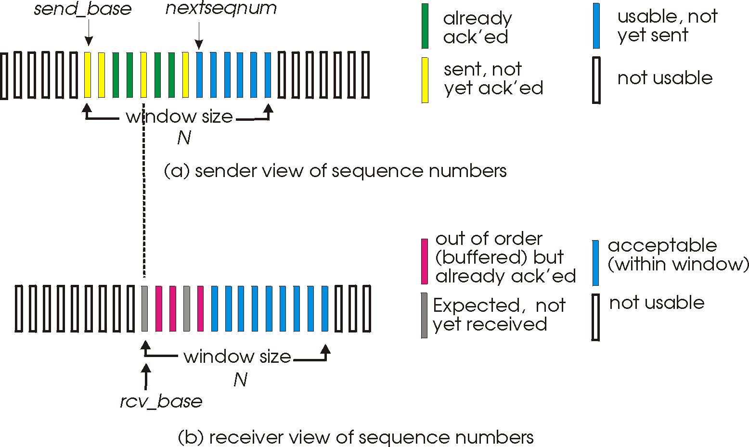
Selective Repeat: Sender, Receiver Windows

Slide 39
Selective Repeat
sender
receiver
Data from above :
If next available seq # in window, send pkt
Timeout(n):
Resend pkt n, restart timer
ACK(n) in [sendbase,sendbase+N]:
Mark pkt n as received
If n smallest unACKed pkt, advance window base to next unACKed seq #
pkt n in [rcvbase, rcvbase+N-1]
Send ACK(n)
Out-of-order: buffer
In-order: deliver (also deliver buffered, in-order pkts), advance window to next not-yet-received pkt
pkt n in [rcvbase-N,rcvbase-1]
ACK(n)
Otherwise:
Ignore

Slide 40
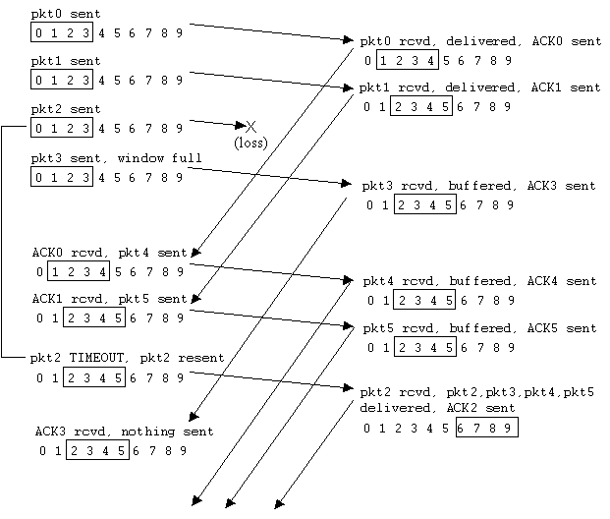
Selective Repeat In Action

Slide 41
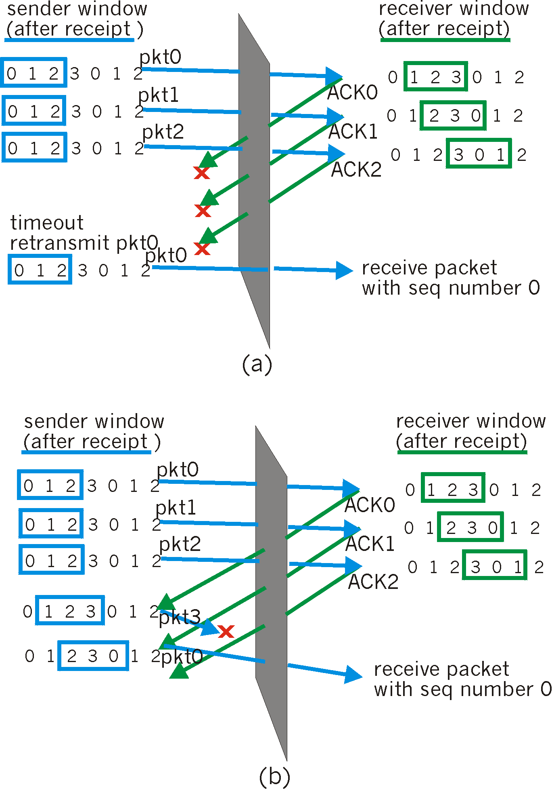
Selective Repeat: Dilemma
Example:
seq #’s: 0, 1, 2, 3
window size=3
Receiver sees no difference in two scenarios!
Incorrectly passes duplicate data as new in (a)
Q: what relationship between seq # size and window size?

Slide 42
GBN vs. Selective Repeat
Selective repeat is more complicated as it needs buffering at the receiver, but only retransmit packets required for retransmission
GBN is simpler, but can lead to large number of unnecessary retransmission

Slide 43
Exercises-3
The data link layer uses the GBN protocol, and the sender has sent frames numbered 0 ~ 7. When the timer expires, if the sender only receives the acknowledgement of frames 0, 2 and 3, the number of frames to be retransmitted by the sender is ( )
A. 2 B. 3 C. 4 D.5
3-43
Notes:
C

Slide 44
Exercise-3
2. Considering GBN protocol and SR protocol, assuming that the length of sequence number space is n, what is the maximum allowed sender window?
3-44
Notes:
GBN:1<W_{T}<2^N-1, W_{R}=1
SR:

Slide 45
Multiple Access Links and Protocols
Three types of “links”:
point-to-point (single wire, e.g. PPP, SLIP)
broadcast (shared wire or medium; e.g, Ethernet, Wavelan, etc.)
switched (e.g., switched Ethernet, ATM etc)
3-45

Slide 46
Multiple Access protocols
single shared communication channel
two or more simultaneous transmissions by nodes: interference
collision if node receives two or more signals at the same time
only one node can send successfully at a time
multiple access protocol:
distributed algorithm that determines how nodes share channel, i.e., determine when node can transmit
communication about channel sharing must use channel itself!
what to look for in multiple access protocols:
synchronous or asynchronous
information needed about other stations
robustness (e.g., to channel errors)
performance

Slide 47
Multiple Access protocols
claim: humans use multiple access protocols all the time
class can "guess" multiple access protocols
multiaccess protocol 1:
multiaccess protocol 2:
multiaccess protocol 3:
multiaccess protocol 4:

Slide 48
MAC Protocols: a taxonomy
Three broad classes:
Channel Partitioning
divide channel into smaller “pieces” (time slots, frequency)
allocate piece to node for exclusive use
Random Access
allow collisions
“recover” from collisions
“Taking turns”
tightly coordinate shared access to avoid collisions
Goal: efficient, fair, simple, decentralized

Slide 49
Channel Partitioning MAC protocols: TDMA
TDMA: time division multiple access
access to channel in "rounds"
each station gets fixed length slot (length = pkt trans time) in each round
unused slots go idle
example: 6-station LAN, 1,3,4 have pkt, slots 2,5,6 idle
6-slot
frame
6-slot
frame
1
3
4
1
3
4
Notes:
TDM (Time Division Multiplexing): channel divided into N time slots, one per user; inefficient with low duty cycle users and at light load.
FDM (Frequency Division Multiplexing): frequency subdivided.

Slide 50
Channel Partitioning MAC protocols: FDMA
FDMA: frequency division multiple access
channel spectrum divided into frequency bands
each station assigned fixed frequency band
unused transmission time in frequency bands go idle
example: 6-station LAN, 1,3,4 have pkt, frequency bands 2,5,6 idle
time
frequency bands
FDM cable

Slide 51
Code Division Multiple Access (CDMA)
unique “code” assigned to each user; i.e., code set partitioning
all users share same frequency, but each user has own “chipping” sequence (i.e., code) to encode data
allows multiple users to “coexist” and transmit simultaneously with minimal interference (if codes are “orthogonal”)
encoded signal = (original data) X (chipping sequence)
decoding: inner-product of encoded signal and chipping sequence

Slide 52
CDMA encode/decode
channel output Z_{i,m}
Z_{i,m}= d_{i}.c_{m}
data
bits
d₀ = 1
1
1
1
1
1
d₁ = -1
1
1
1
-
-
-
-
1
-
-
-
1
-
1
1
1
1
1
sender
1
1
slot 1
channel
output
slot 0
channel
output
1
1
1
1
1
code
1
1
-
-
-
1
-
1
1
1
-
-
-
1
-
1
1
1
slot 1
slot 0
M
D_{i} = Σ Z_{i,m}.c_{m}
m=1
M
received
input
1
1
1
1
1
1
1
1
d₀ = 1
-
-
-
-
1
-
-
-
1
-
1
1
1
1
1
1
d₁ = -1
1
slot 1
channel
output
slot 0
channel
output
1
1
1
1
1
code
1
1
-
-
-
1
-
1
1
1
-
-
-
1
-
1
1
1
receiver
slot 1
slot 0

Slide 53
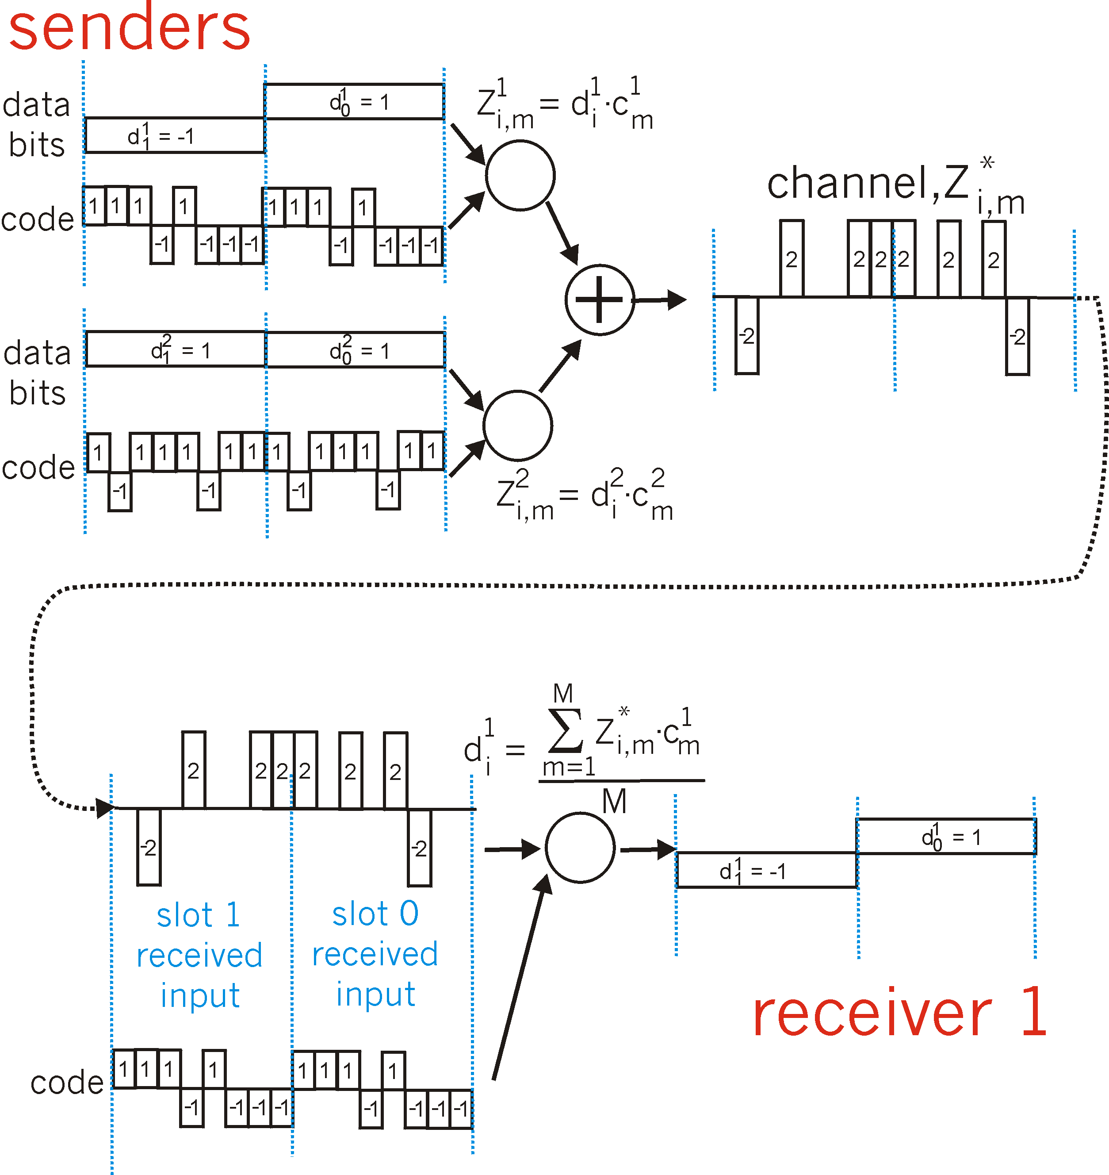
CDMA: two-sender interference
channel sums together transmissions by sender 1 and 2
Sender 1
Sender 2
using same code as sender 1, receiver recovers sender 1’s original data from summed channel data!

Slide 54
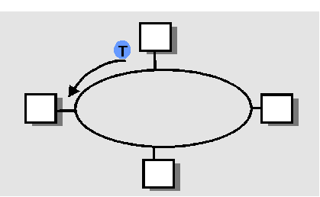
“Taking Turns” MAC protocols
Polling:
master node “invites” slave nodes to transmit in turn
Request to Send, Clear to Send msgs
concerns:
polling overhead
latency
single point of failure (master)
Token passing:
control token passed from one node to next sequentially.
token message
concerns:
token overhead
latency
single point of failure (token)
3-54

Slide 55
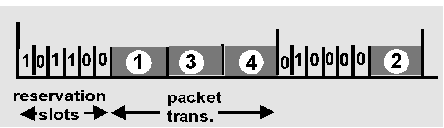
Reservation-based protocols
Distributed Polling:
time divided into slots
begins with N short reservation slots
reservation slot time equal to channel end-end propagation delay
station with message to send posts reservation
reservation seen by all stations
after reservation slots, message transmissions ordered by known priority
3-55

Slide 56
Random Access protocols
When node has packet to send
transmit at full channel data rate R.
no a priori coordination among nodes
two or more trasnmitting nodes -> “collision”,
random access MAC protocol specifies:
how to detect collisions
how to recover from collisions (e.g., via delayed retransmissions)
Examples of random access MAC protocols:
ALOHA
slotted ALOHA
CSMA and CSMA/CD

Slide 57
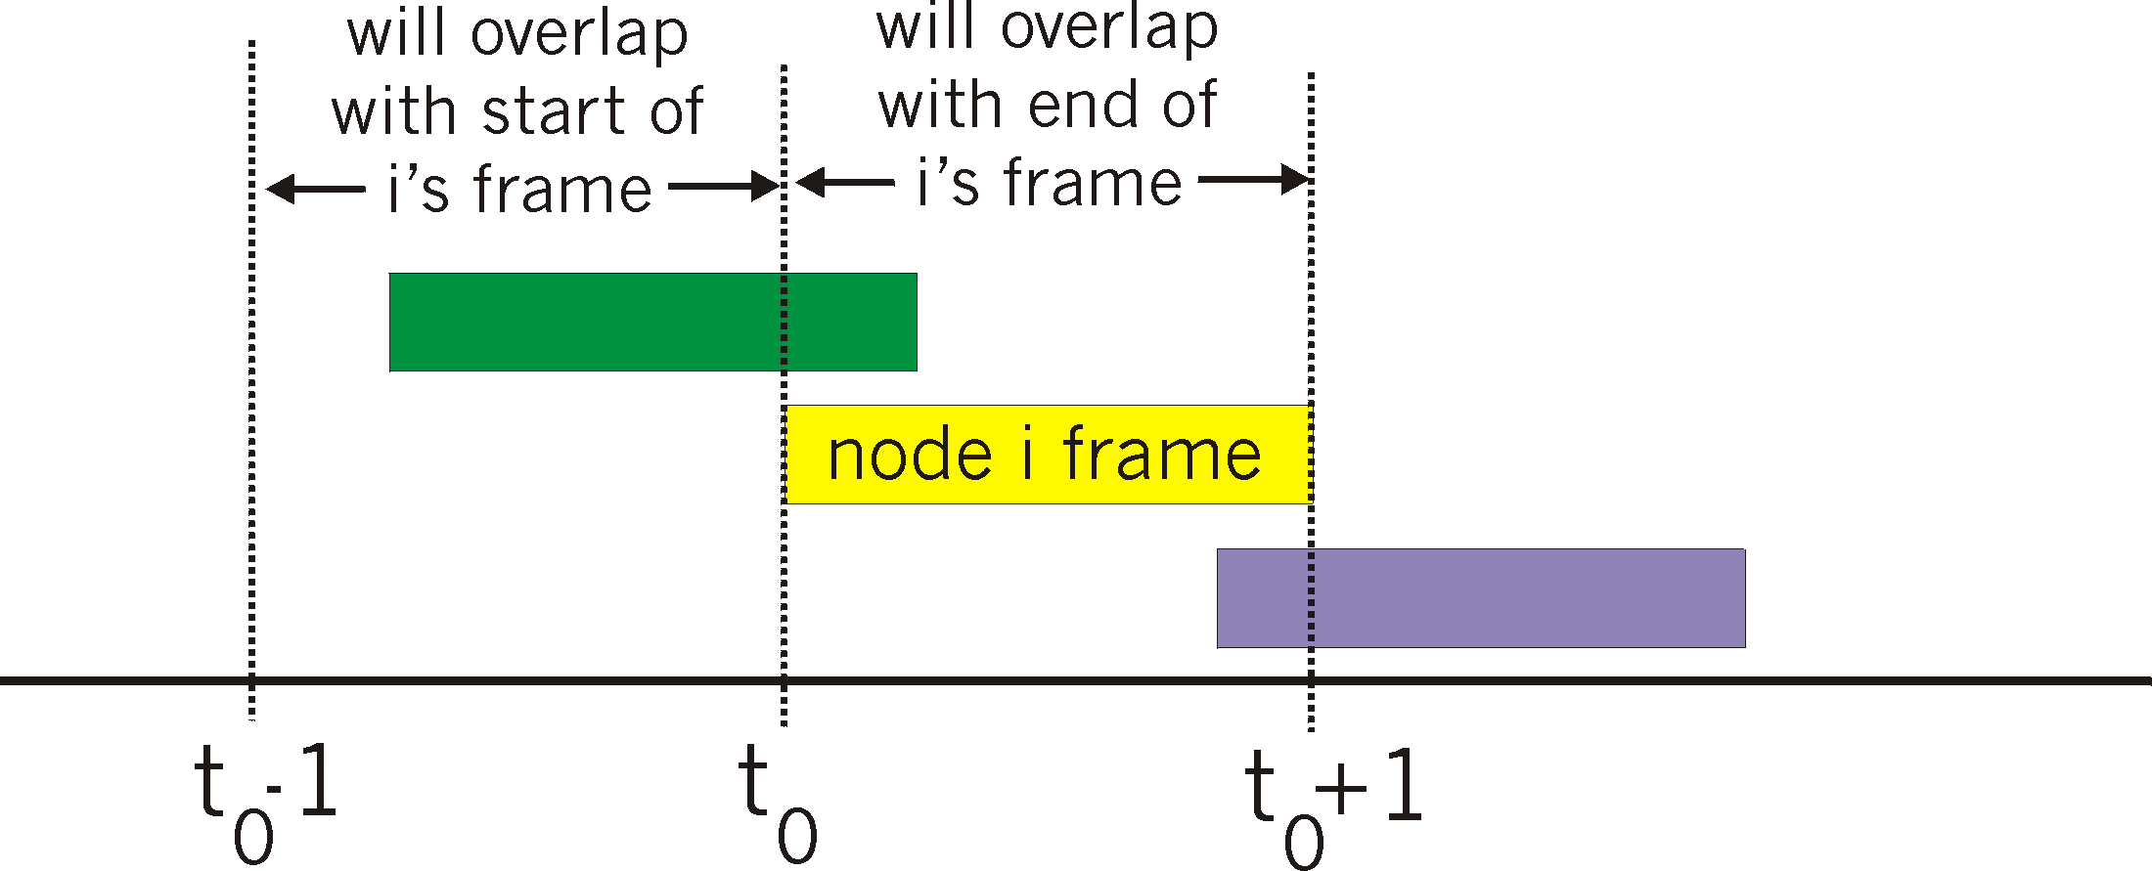
Pure ALOHA
unslotted Aloha: simpler, no synchronization
pkt needs transmission:
send without awaiting for beginning of slot
collision probability increases:
pkt sent at t₀ collide with other pkts sent in [t₀-1, t₀+1]

Slide 58
Pure Aloha (cont.)
P(success by given node) = P(node transmits) .
P(no other node transmits in [p₀-1,p₀] .
P(no other node transmits in [p₀-1,p₀]
= p . (1-p)^{N-1 .} (1-p)^{N-1}
= p . (1-p)^{2(N-1)}
… choosing optimum p as n -> infty ...
^{= 1/(2e) = .18}
0.4
0.3
S = throughput = “goodput”
(success rate)
protocol constrains
effective channel
throughput!
Slotted Aloha
0.2
0.1
Pure Aloha
0.5
1.0
1.5
2.0
G = offered load = Np

Slide 59
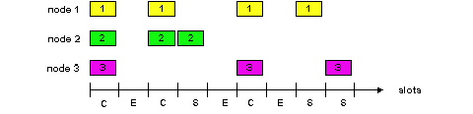
Slotted Aloha
time is divided into equal size slots (= pkt trans. time)
node with new arriving pkt: transmit at beginning of next slot
if collision: retransmit pkt in future slots with probability p, until successful.
Success (S), Collision (C), Empty (E) slots

Slide 60
Slotted Aloha efficiency
Q: what is max fraction slots successful?
A: Suppose N stations have packets to send
each transmits in slot with probability p
prob. successful transmission S is:
by single node: S= p (1-p)^{(N-1)}
by any of N nodes
S = Prob (only one transmits)
= N p (1-p)^{(N-1)}
… choosing optimum p as n -> infty ...
= 1/e = .37 as N -> infty
At best: channel
use for useful
transmissions 37%
of time!

Slide 61
CSMA: Carrier Sense Multiple Access)
CSMA: listen before transmit:
If channel sensed idle: transmit entire frame
If channel sensed busy, defer transmission
Persistent CSMA: retry immediately with probability p when channel becomes idle (may cause instability)
Non-persistent CSMA: retry after random interval
human analogy: don’t interrupt others!

Slide 62
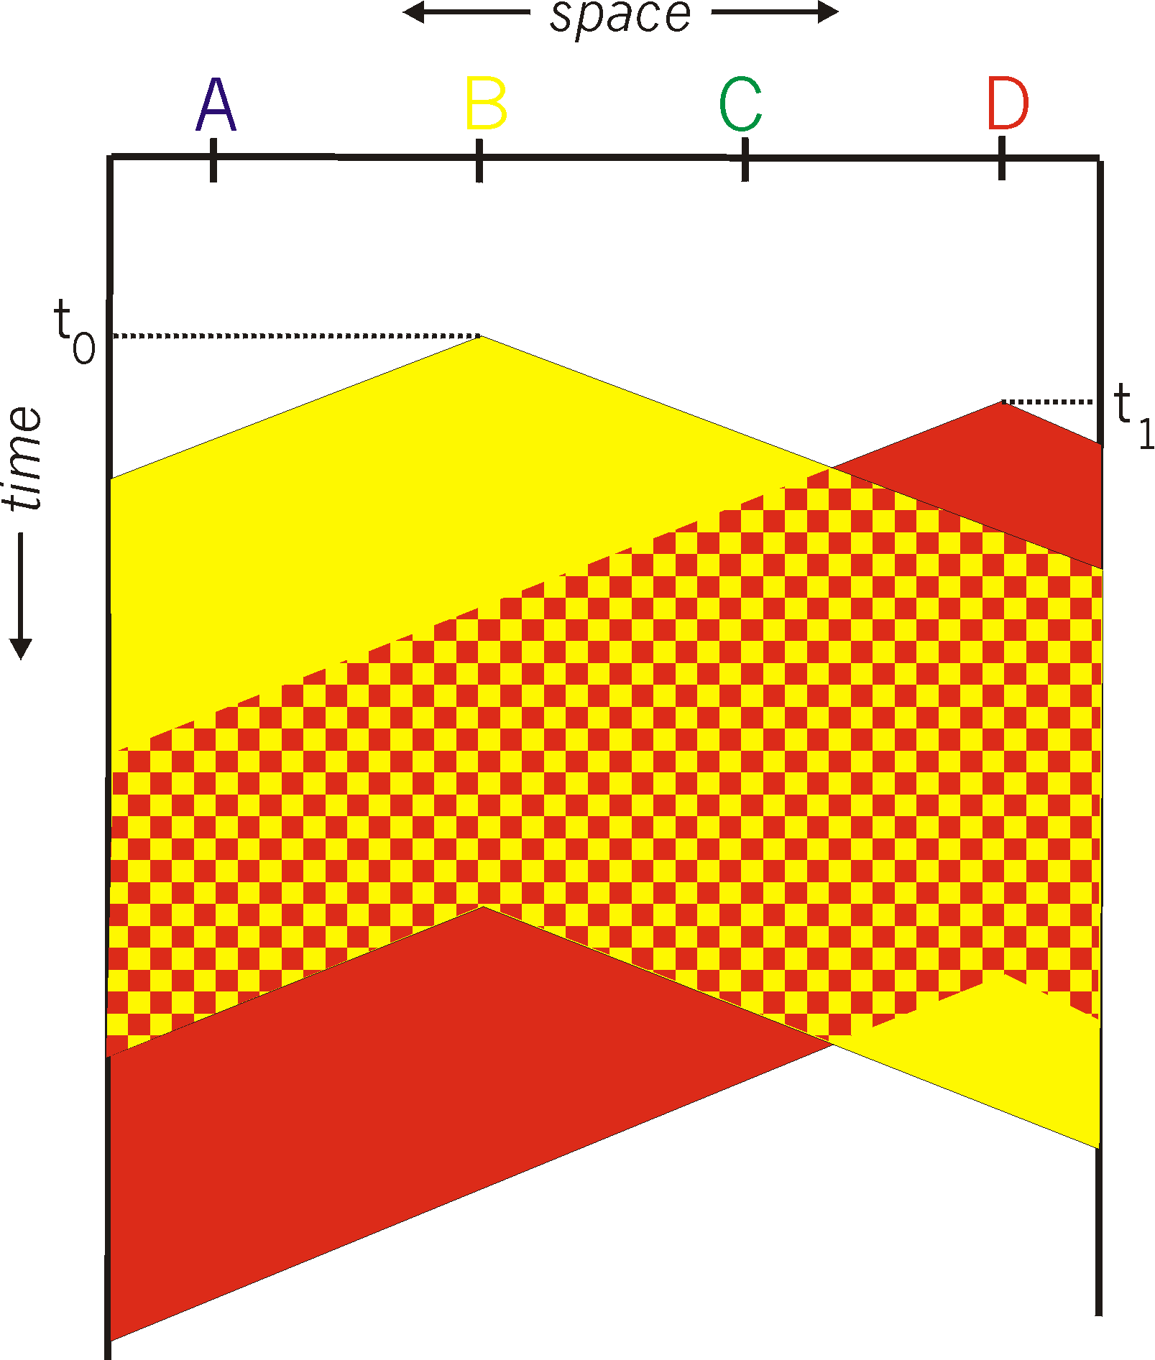

CSMA collisions
spatial layout of nodes
collisions can occur:
propagation delay means
two nodes may not year
hear each other’s transmission
collision:
entire packet transmission
time wasted
note:
role of distance and propagation delay in determining collision prob.

Slide 63
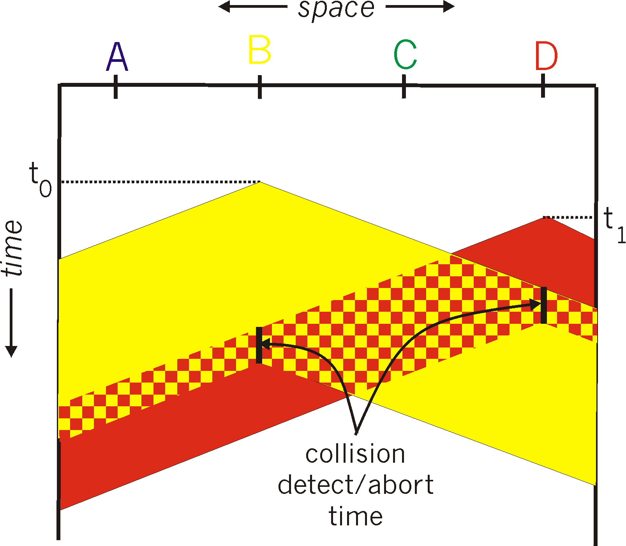
CSMA/CD collision detection

Slide 64
CSMA/CD (Collision Detection)
A
1 km
B
t = 0
B sending a packet
collision
A detect a collision
t = τ − δ
t
t = τ
τ :one way propagation delay
t = 2τ − δ
B detect a collision
t = 0, A find that the channel is idle, then sending data
A
B
t = τ − δ
B find that the channel is idle, then sending data
A
B
A
B
t = τ − δ / 2
collision
t = τ
B detect the collision, then stop sending
A
B
STOP
t = 2τ − δ
A detect the collision, then stop sending
STOP
A
B
2τ :Contention Period

Slide 65
CSMA/CD (Collision Detection)
CSMA/CD: carrier sensing, deferral as in CSMA
collisions detected within short time
colliding transmissions aborted, reducing channel wastage
persistent or non-persistent retransmission
collision detection:
easy in wired LANs: measure signal strengths, compare transmitted, received signals
difficult in wireless LANs: receiver shut off while transmitting
human analogy: the polite conversationalist

Slide 66
CSMA/CD efficiency
T_{prop} = max prop delay between 2 nodes in LAN
t_{trans} = time to transmit max-size frame
efficiency goes to 1
as t_{prop} goes to 0
as t_{trans} goes to infinity
better performance than ALOHA: and simple, cheap, decentralized!

Slide 67
Summary of MAC protocols
What do you do with a shared media?
Channel Partitioning, by time, frequency or code
Time Division,Code Division, Frequency Division
Random partitioning (dynamic),
ALOHA, S-ALOHA, CSMA, CSMA/CD
carrier sensing: easy in some technoligies (wire), hard in others (wireless)
CSMA/CD used in Ethernet
Taking Turns
polling from a central cite, token passing

Slide 68
Summary of MAC protocols
channel partitioning MAC protocols:
share channel efficiently at high load
inefficient at low load: delay in channel access, 1/N bandwidth allocated even if only 1 active node!
Random access MAC protocols
efficient at low load: single node can fully utilize channel
high load: collision overhead
“taking turns” protocols
look for best of both worlds!
3-68

Slide 69
Exercises-4
A LAN adopts CSMA/CD protocol to realize the media access control. The data transmission rate is 10Mbps, the distance between host A and host B is 2km, and the signal propagation speed is 200000km/s. If there is a conflict when two hosts send data, how long will it take from the time when they start sending data to the time when both hosts detect the conflict? (What is the minimum and maximum duration?)
3-69

Slide 70
Chapter 3: Summary
principles behind data link layer services:
framing
error detection, correction
reliable data transfer
sharing a broadcast channel: multiple access
Next, various link layer technologies
LAN Model
Ethernet
WLAN

Slide 71
Homework
P319-322
P9,11,17,22
P537
P5
3-71

